Slide 1



REPUBLIC OF CAMEROON
Peace - Work - Fatherland
REPUBLIQUE DU CAMEROUN
Paix – Travail - Patrie
AFRICAN INSTITUTE OF COMPUTER SCIENCES - CAMEROON OFFICE
PAUL BIYA TECHNOLOGICAL CENTER OF EXCELLENCE
P.O. Box: 13719 Yaoundé
Tel: +237.242.729.957 Fax: 22729958
E-mail: contact@iaicameroun.com
Web site: www.iaicameroun.com
THINK BIG, START SMALL, START NOW
Tel: (237) 620256960/654486985
Email : realize.contactus@gmail.com
Web site: www.realize.cm
Internship carried out from the 03rd of July till the 30th of September 2024. In view of obtaining a Software Engineering Diploma in Computer Sciences Option: Software Engineering
Written by:
NSAN SAMUEL PENIEL
Level II Software Engineering student
Supervision
Professional Supervisor:
Mr. MENGOT NSO
Software Engineer
Academic Supervisor:
Mr. ASSANE DERICK
Lecturer at AICS-Cameroon
Academic Year 2024 - 2025

Slide 2
Waste COLLECTION SYSTEM
Here is where your presentation begins.

Slide 3
Table of contents
01
Introduction
02
Context and Problematic
03
Methodology
04
Demonstration
05
Conclusion

Slide 4
01
INTRODUCTION
You can enter a subtitle here if you need it

Slide 5
GENERAL PRESENTATION OF REALIZE
A. History
Realize is a Cameroon-based NGO and tech start-up founded by Mr. NDELOGAKEH DANIEL in 2022. It offers IT solutions and promotes the use of new technologies in Cameroon.
B. Vision
Realize believes that unlocking the potential of organizations and individuals is possible through analysis, development, realization, and data analytics.

Slide 6
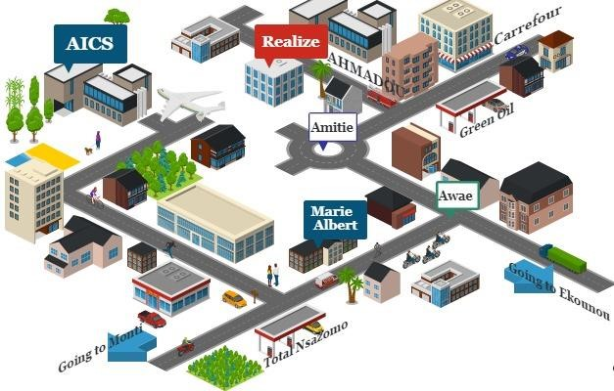
GEOGRAHICAL LOCATION
REALIZE is located at Yaoundé-Valler Amadou Ekie

Slide 7
02
Context and Problematics
You can enter a subtitle here if you need it

Slide 8
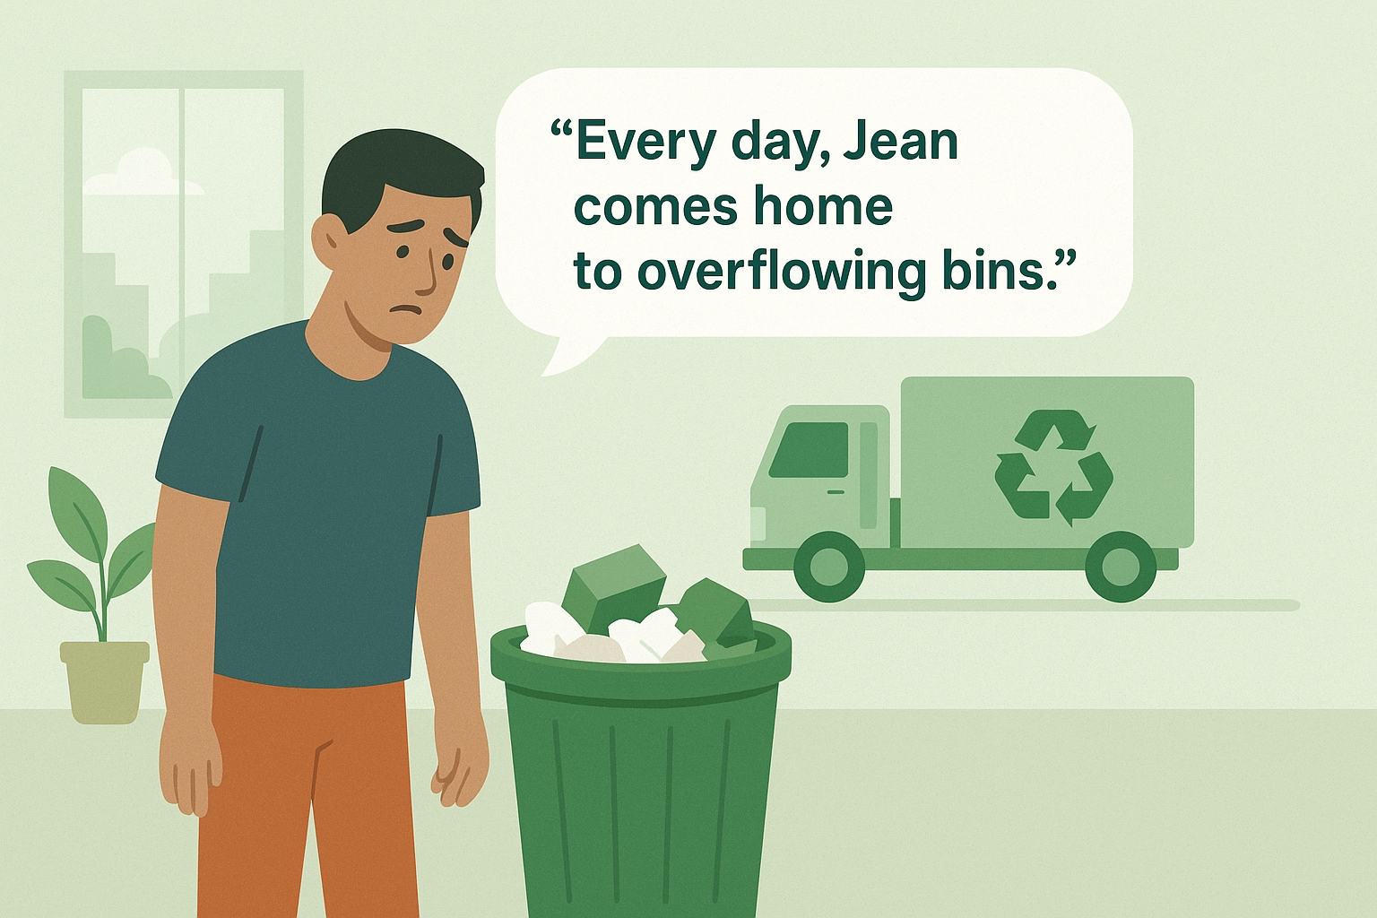
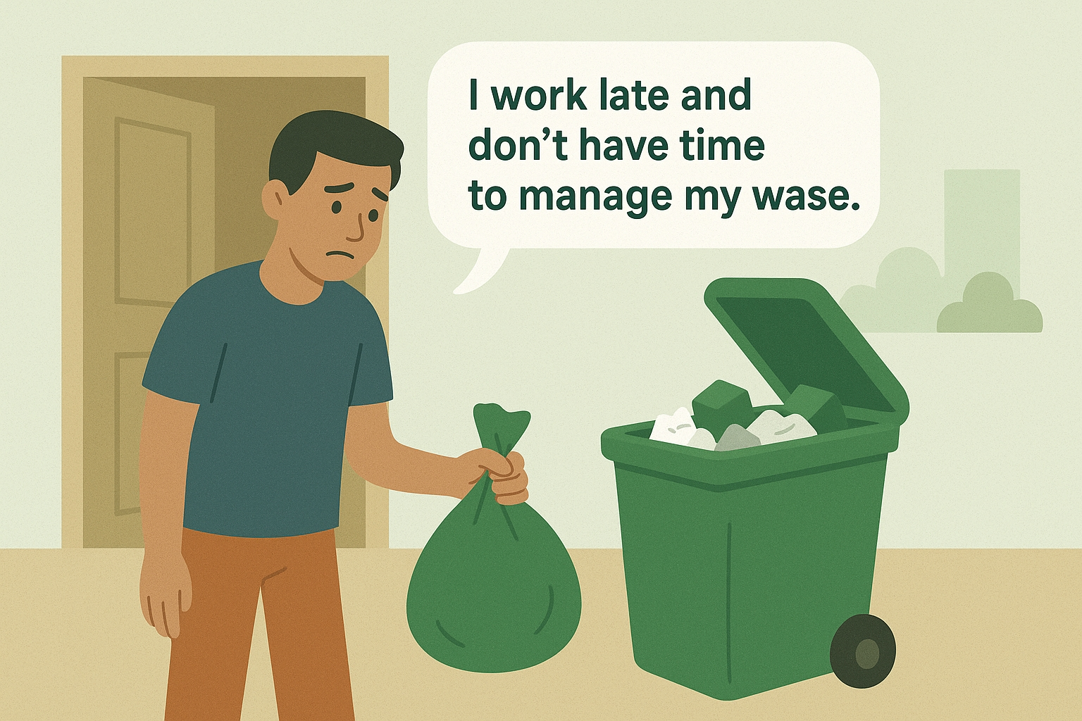
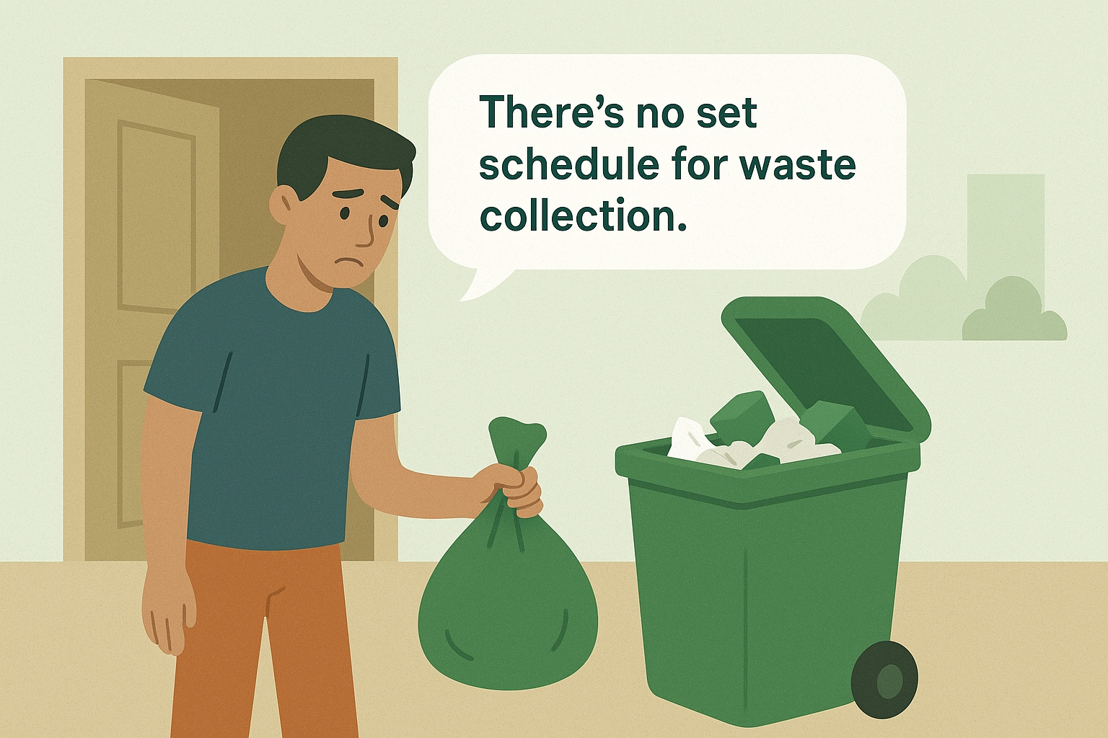
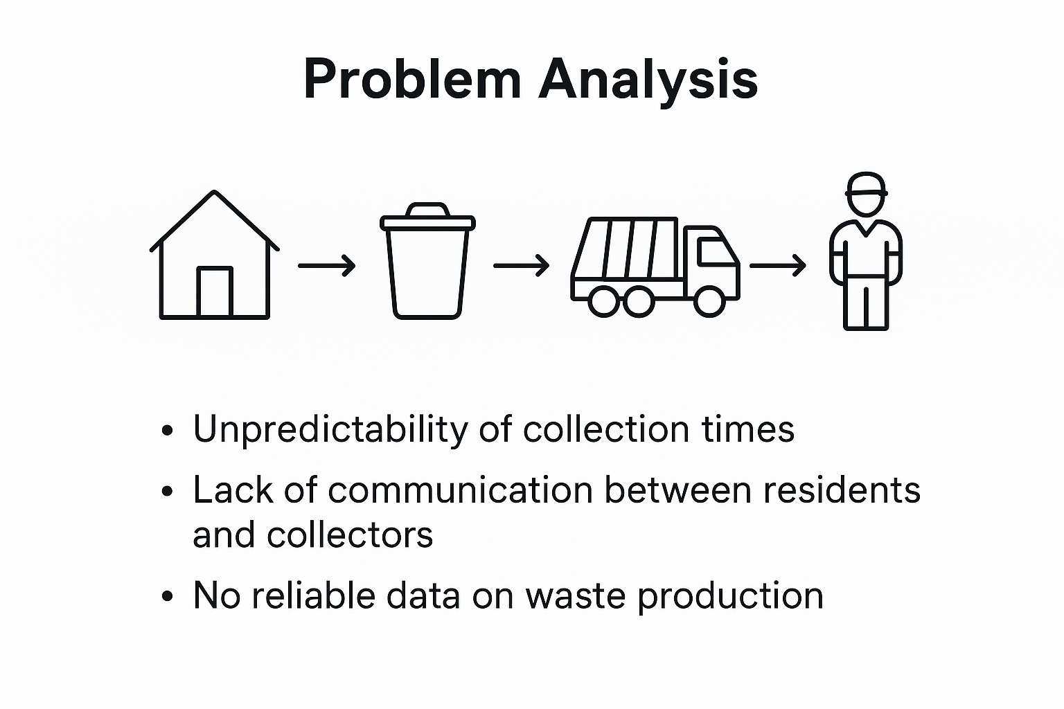

Slide 9
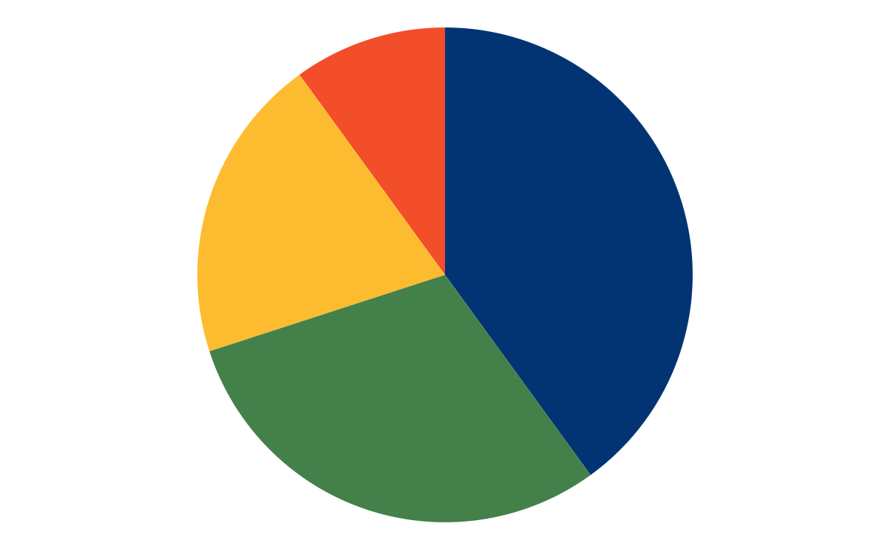
Challenges to waste management in Buea
poor implementation of stated laws on waste management
10%
40%
Lack of public sensitization
Inability to recycle and/or reuse
20%
30%
poor accessibility
CONTEXT
Give problems and consequences of the existing system
Waste composition includes household, commercial and industrial waste with a notable amount of plastic waste.
In yaounde a certain amount of 1800 tons of waste daily.

Slide 10
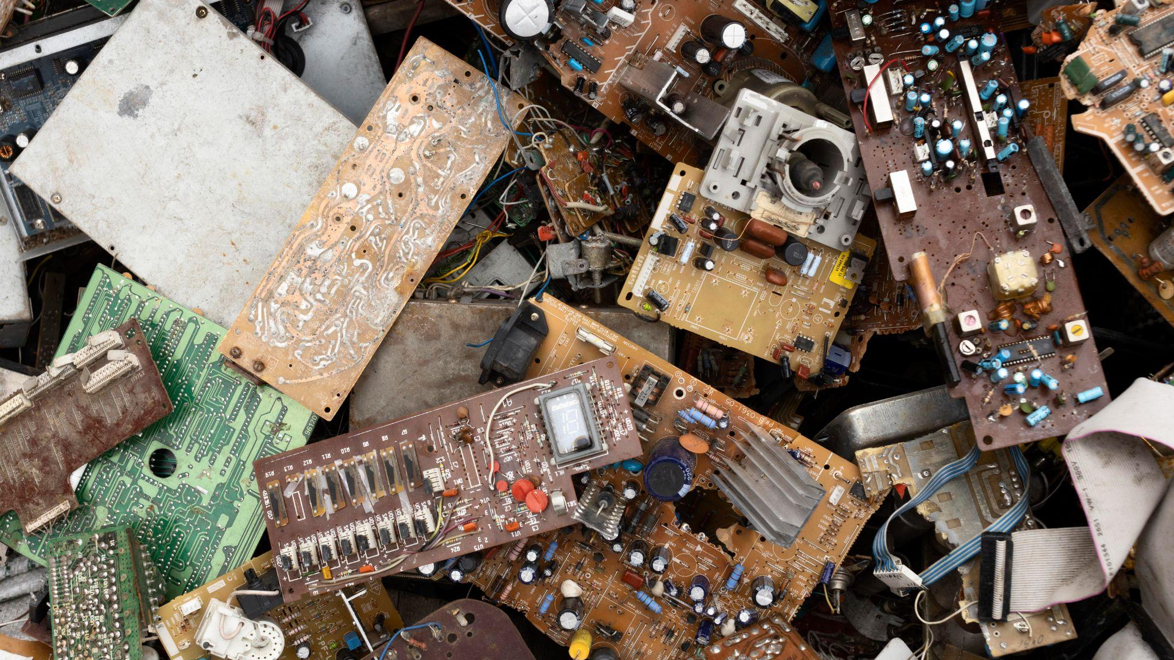
A picture is worth a thousand words

Slide 11
6,000,000
Cameroon generates tonnes of waste annually.

Slide 12

Problematics
In our communities, we are all familiar with the sight of uncollected waste and the resulting nuissance.
This poses a critical question?
“How can we solve the problem of inefficient waste collection that leads to environmental pollution and public health hazards?.....”

Slide 13
Proposed Solutions
The solution is a digital waste collection system which is Zerodech,that combines a mobile app, GPS tracking, payment integration, and intelligent pickup scheduling. It aims to increase efficiency, transparency, and accessibility while reducing the limitations of manual collection in hard-to-reach areas.
Mobile Application for Residents
Real-Time Location Tracking
Digital Subscription and Payment
Develop a user-friendly app allowing residents to register, subscribe, and make payments.
Use GPS APIs to track households’ locations, especially in hard-to-reach or inaccessible areas.
Maintain a database of subscribers, tracking payment status and subscription history in real time.

Slide 14
03
Methodology
You can enter a subtitle here if you need it

Slide 15
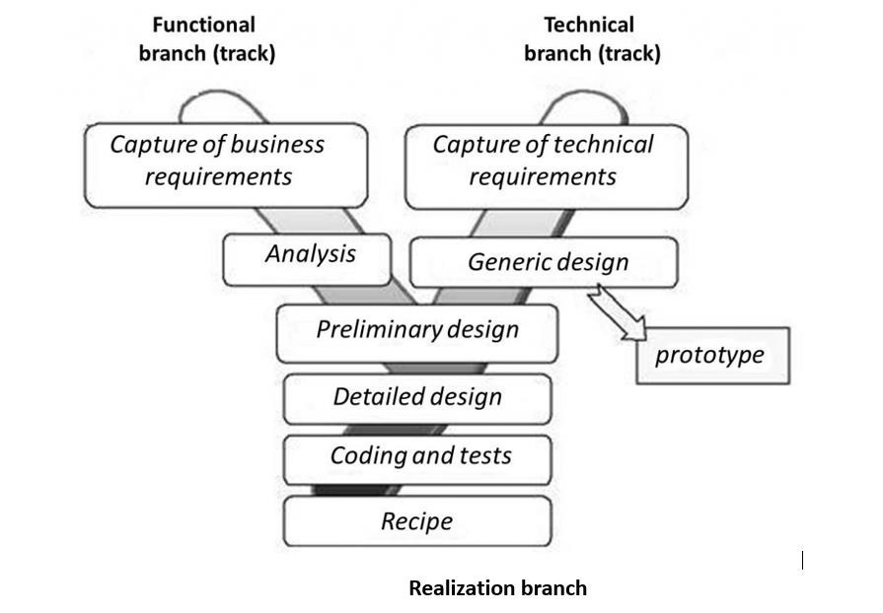

2TUP

Slide 16
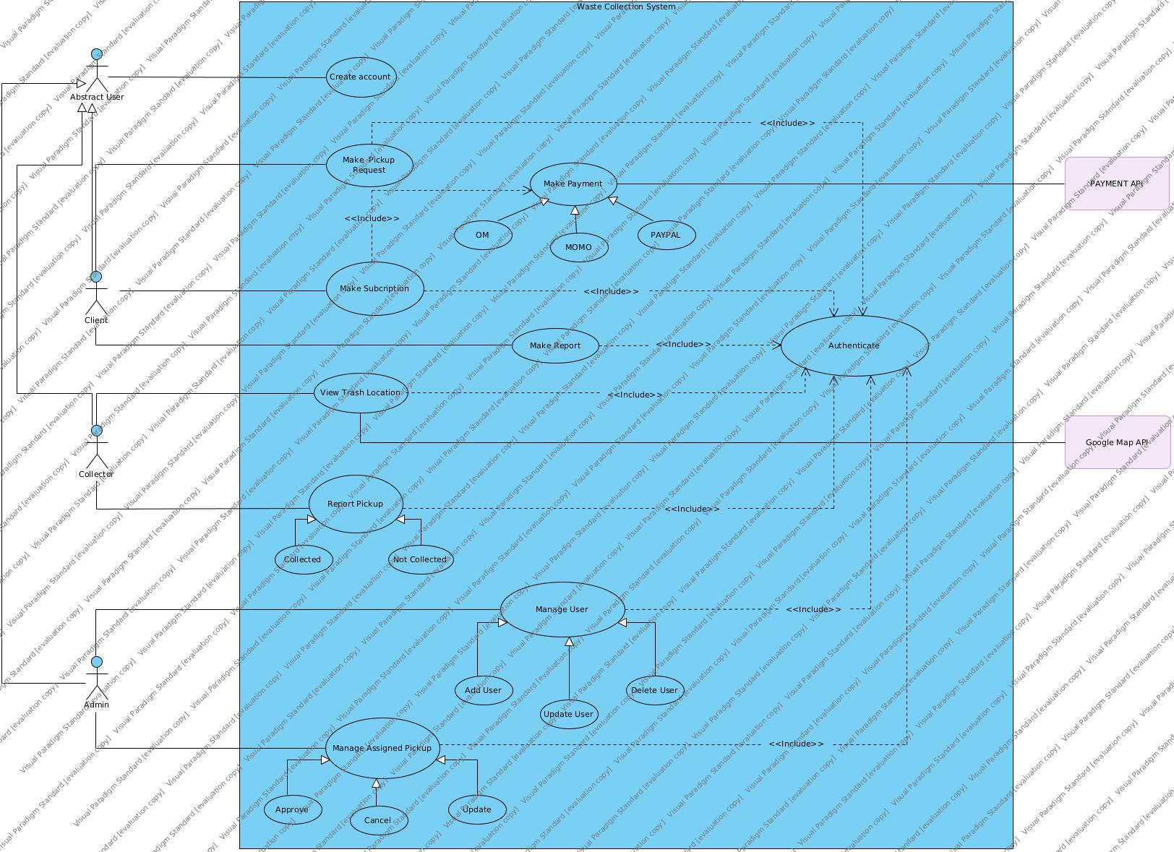
GENERAL USE CASE DIAGRAM

Slide 17
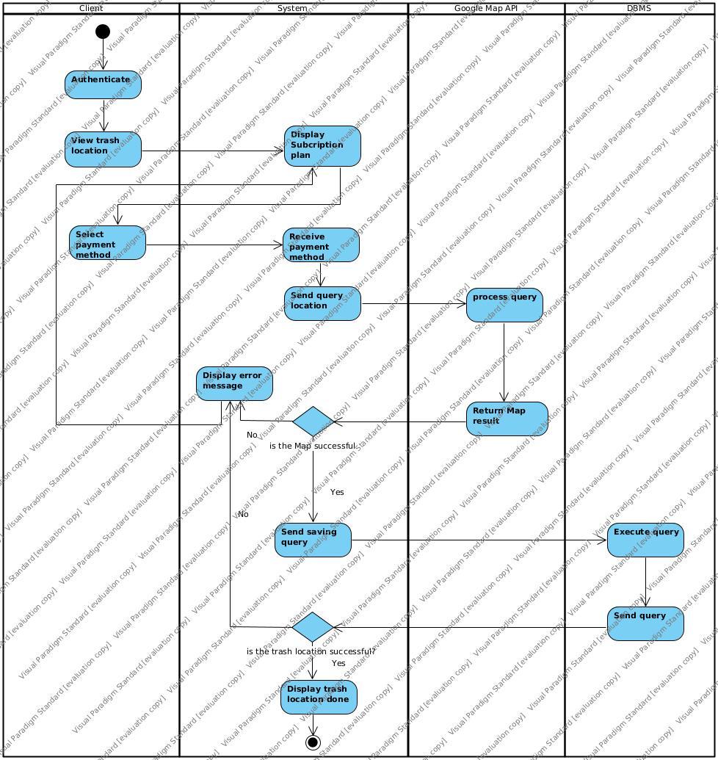
Make Payment Activity Diagram

Slide 18







Slide 19
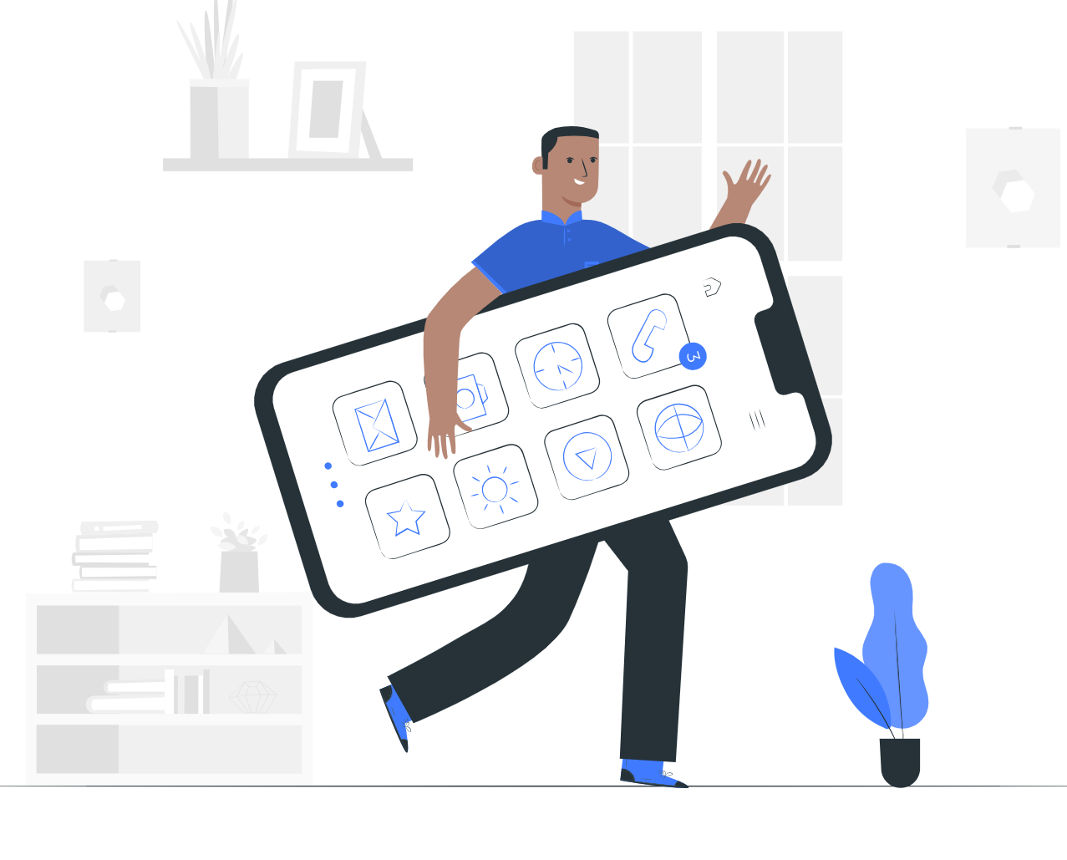

04
Demonstration
You can enter a subtitle here if you need it

Slide 20
Conclusion
05
Zerodech app.
No body is perfect, we are open to all critisms.

Slide 21

Thanks!

Slide 22
Alternative resources
Here’s an assortment of alternative resources whose style fits the one of this template:
Vectors
Hand drawn people using technological devices pack

